Slide 1




NEXT GEN EMPLOYABILITY PROGRAM
Creating a future-ready workforce
Team Members
College Name
Student Name :PAVITHRA K
Student ID :511321104065
Kingston engineering college

Slide 2

CAPSTONE PROJECT SHOWCASE
Project Title
Building Bus Reservation System using Python and Django
Abstract | Problem Statement | Project Overview | Proposed Solution | Technology Used | Modelling & Results | Conclusion

Slide 3
Abstract
This abstract presents the development of a Bus Reservation System using Python and Django, emphasizing the full stack approach. The project aims to provide an efficient and user-friendly platform for booking bus tickets online, streamlining the process for both customers and bus operators.
The system's backend is implemented in Python, leveraging the Django framework for its robustness, scalability, and security features. Django's built-in authentication system ensures secure user access and authorization. Additionally, Django's ORM facilitates seamless interaction with the database, enhancing data management and retrieval.
On the frontend, HTML, CSS, and JavaScript are utilized to design a responsive and intuitive user interface. The frontend communicates with the backend through AJAX requests, enabling dynamic updates without page reloads. The use of modern frontend frameworks such as Bootstrap enhances the system's aesthetics and responsiveness, ensuring compatibility across various devices and screen sizes.
Source :

Slide 4
Problem Statement
Developing a user-friendly and efficient bus reservation system using Python and Django to address the shortcomings of existing systems. Challenges include enhancing user experience, providing comprehensive administration tools, ensuring scalability and security, integrating payment gateways, implementing reporting and analytics features, and maintaining flexibility for future enhancements. This project aims to streamline the booking process for passengers while offering administrators robust management capabilities, ultimately improving the overall efficiency and experience in the transportation sector.
Source :

Slide 5
Project Overview
This project entails the development of a modern bus reservation system utilizing Python and Django. The system will revolutionize the booking experience for passengers and enhance management efficiency for administrators. Key features include an intuitive user interface for seamless booking, comprehensive administration tools for managing routes, schedules, and bookings, integration of secure payment gateways, and implementation of reporting and analytics functionalities. The system will prioritize scalability and security to handle high volumes of users and transactions while protecting against common vulnerabilities. By leveraging the capabilities of Python and Django, the project aims to deliver a robust and scalable solution that meets the evolving needs of the transportation industry. Through this endeavor, we seek to streamline bus ticket booking, improve operational efficiency, and enhance the overall experience for both passengers and administrators in the realm of transportation.
Source :

Slide 6
Proposed Solution
.
Our solution involves leveraging the Python programming language and Django framework to develop a comprehensive bus reservation system. Utilizing Django's built-in features, we will create an interactive user interface for passengers to easily search, select, and book bus tickets. For administrators, we will design a centralized dashboard to manage routes, schedules, bookings, and user accounts efficiently. Integration with secure payment gateways will facilitate seamless online transactions. To ensure scalability, the system architecture will be designed to handle high volumes of concurrent users and data transactions. Security measures will include protection against common vulnerabilities such as SQL injection and cross-site scripting. Additionally, we will implement reporting and analytics features to provide insights on ticket sales, route popularity, and revenue trends. Through continuous iteration and feedback, our solution will remain flexible and adaptable to evolving requirements, ensuring a seamless and efficient bus reservation experience for all stakeholders.
Source :

Slide 7
Our solution entails developing a robust bus reservation system using Python and Django, focusing on user experience and administrative efficiency. We will employ responsive web design principles to create an intuitive and mobile-friendly interface for passengers to easily browse routes, select seats, and make secure bookings. For administrators, a comprehensive dashboard will facilitate efficient management of bus schedules, seat allocations, and user accounts. Integration with popular payment gateways will enable seamless and secure transactions. To ensure scalability, we will leverage Django's scalability features and employ database optimization techniques. Security measures will include data encryption, user authentication, and protection against common web vulnerabilities. Furthermore, implementing real-time updates for seat availability and bus schedules will enhance user satisfaction. Through iterative development and user feedback, our solution will continuously evolve to meet the dynamic needs of the transportation industry, providing a seamless and efficient bus reservation experience for passengers and administrators alike.
Source :

Slide 8
Proposed Solution:
Our solution focuses on developing a comprehensive bus reservation system using Python and Django, prioritizing simplicity, efficiency, and scalability. We will create a user-friendly interface for passengers, allowing them to easily search for routes, select seats, and complete bookings seamlessly. Administrators will have access to a centralized dashboard for managing bus schedules, seat allocations, and user accounts efficiently. Integration with secure payment gateways will facilitate smooth transactions. To ensure scalability, we will employ Django's built-in scalability features and optimize database performance. Security measures will include encryption, secure user authentication, and protection against common web vulnerabilities. Additionally, implementing real-time notifications for seat availability and bus updates will enhance the user experience. Through continuous testing, feedback, and iterative development, our solution will evolve to meet the evolving needs of the transportation industry, providing a reliable and user-friendly bus reservation platform for both passengers and administrators.
Source :

Slide 9

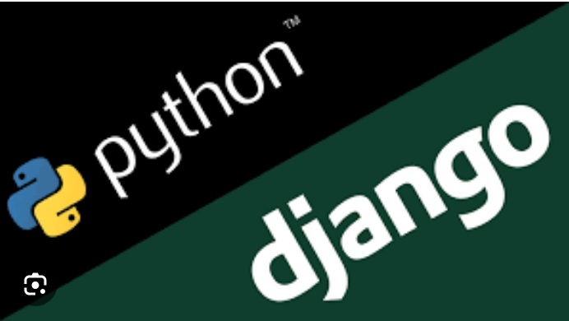
Technology Used
Front-end
Back-end
Source :

Slide 10
Modelling & Results
The bus reservation system is modeled and implemented using Python and Django, encompassing various key functionalities to cater to both passengers and administrators. User authentication and authorization are managed through Django's built-in system, ensuring secure registration, login, and profile management. Bus route management is facilitated by a Django model, enabling administrators to effortlessly add, update, and delete routes via the admin dashboard. Seat allocation logic is integrated, allowing passengers to view and select available seats for their chosen routes during the booking process. Bookings are managed through a Django model, enabling users to seamlessly book tickets, select seats, and make secure payments via integrated gateways. Upon successful booking, users receive digital tickets containing trip details. An intuitive admin dashboard provides administrators with comprehensive tools for managing routes, bookings, and user accounts. Additionally, the system generates reports and analytics on ticket sales, route popularity, and revenue trends, empowering decision-making and strategic planning. Through these modeled functionalities, the bus reservation system optimizes both user experience and administrative efficiency.
Source :

Slide 11
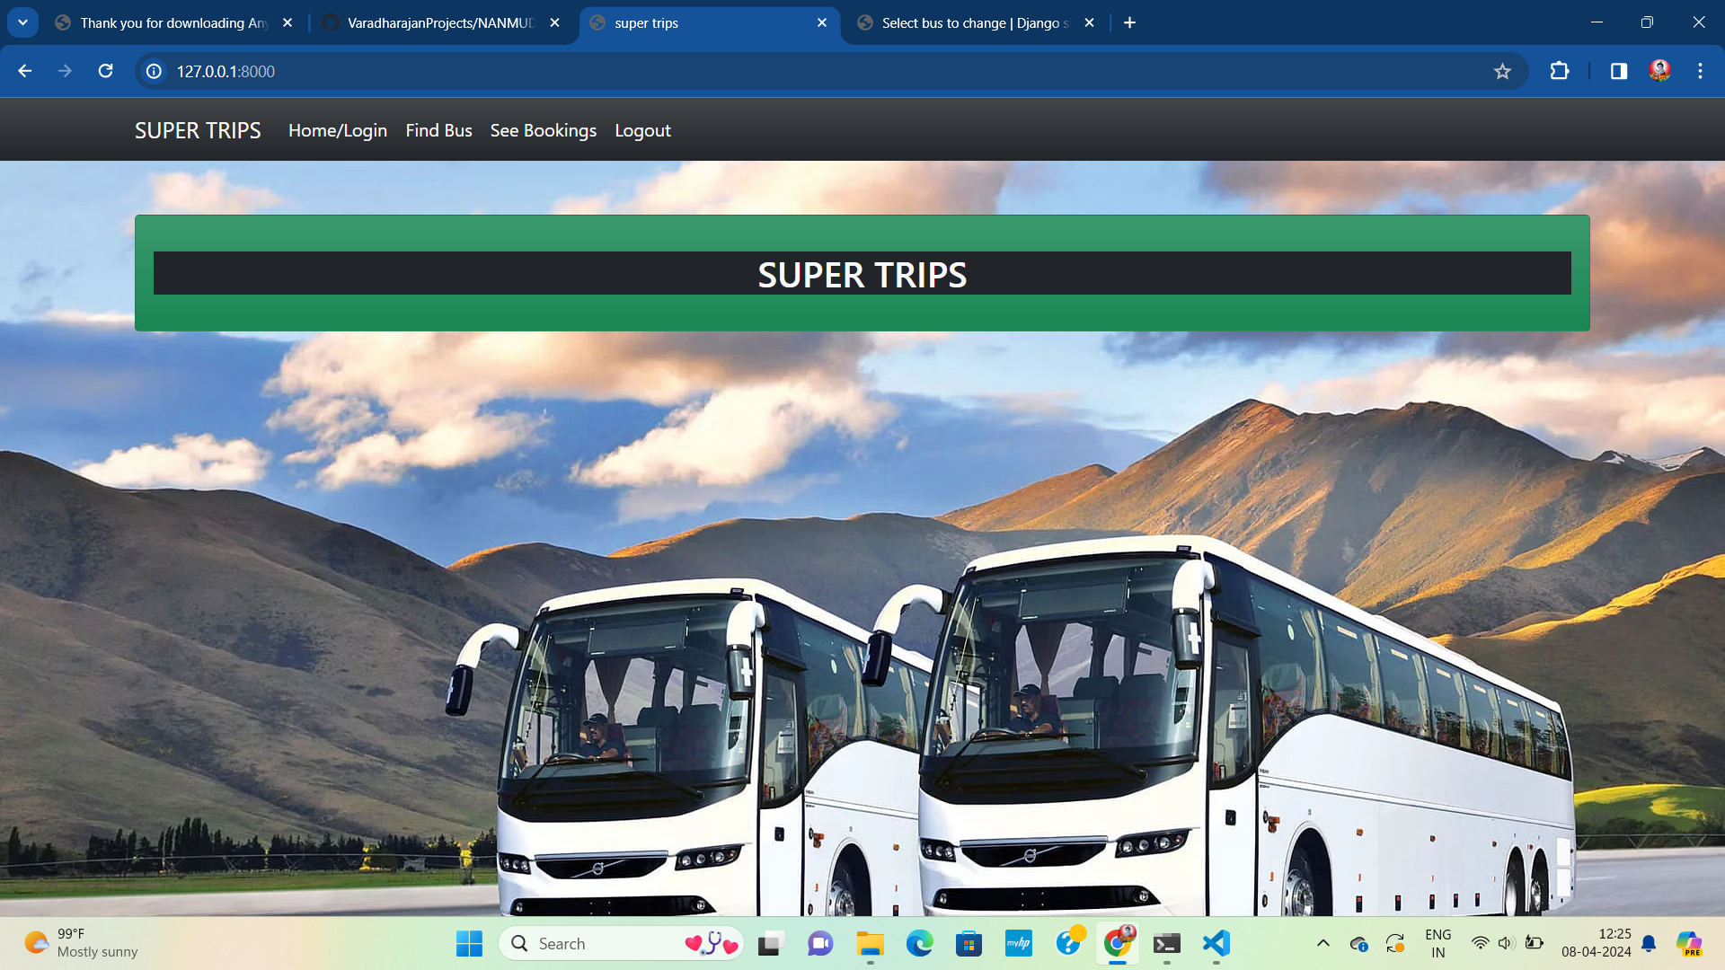
Homepage

Slide 12
About-Us-Page

Slide 13
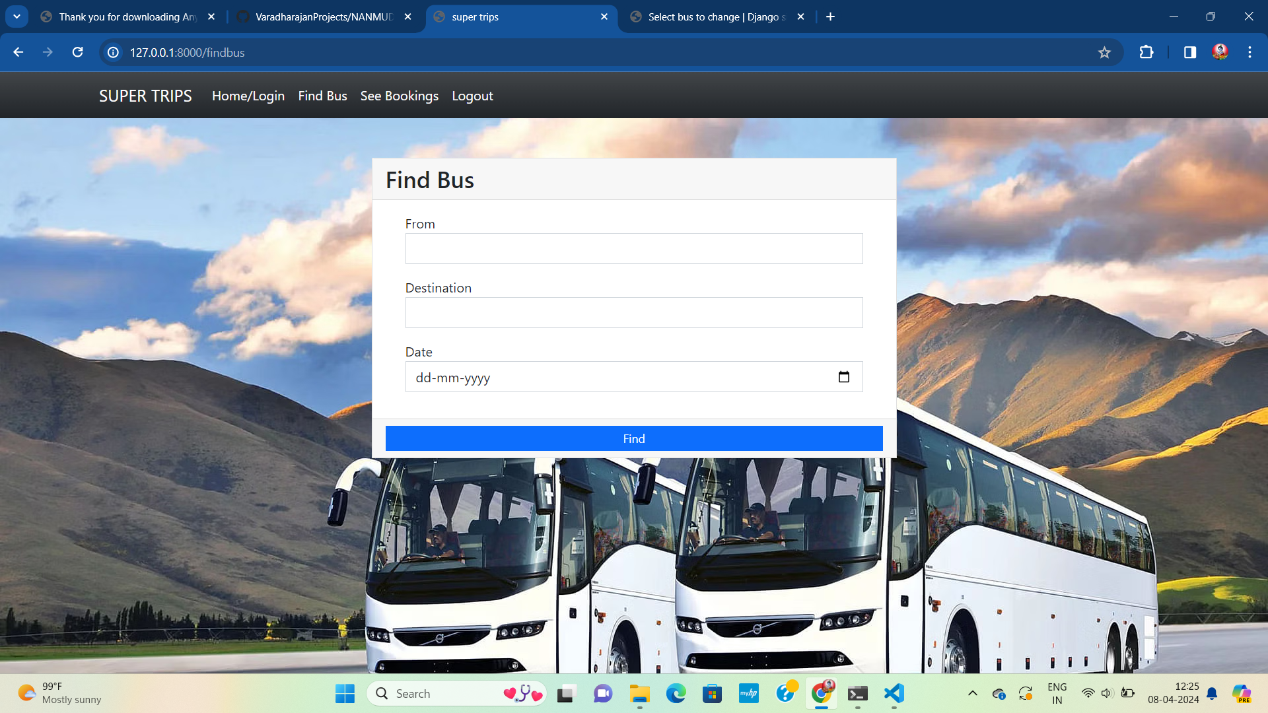
Service-Page

Slide 14
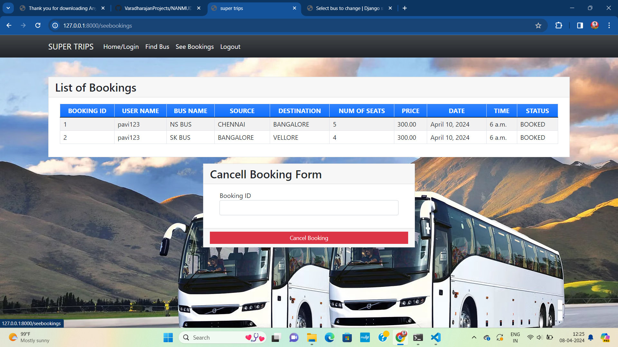
Departments-Page

Slide 15
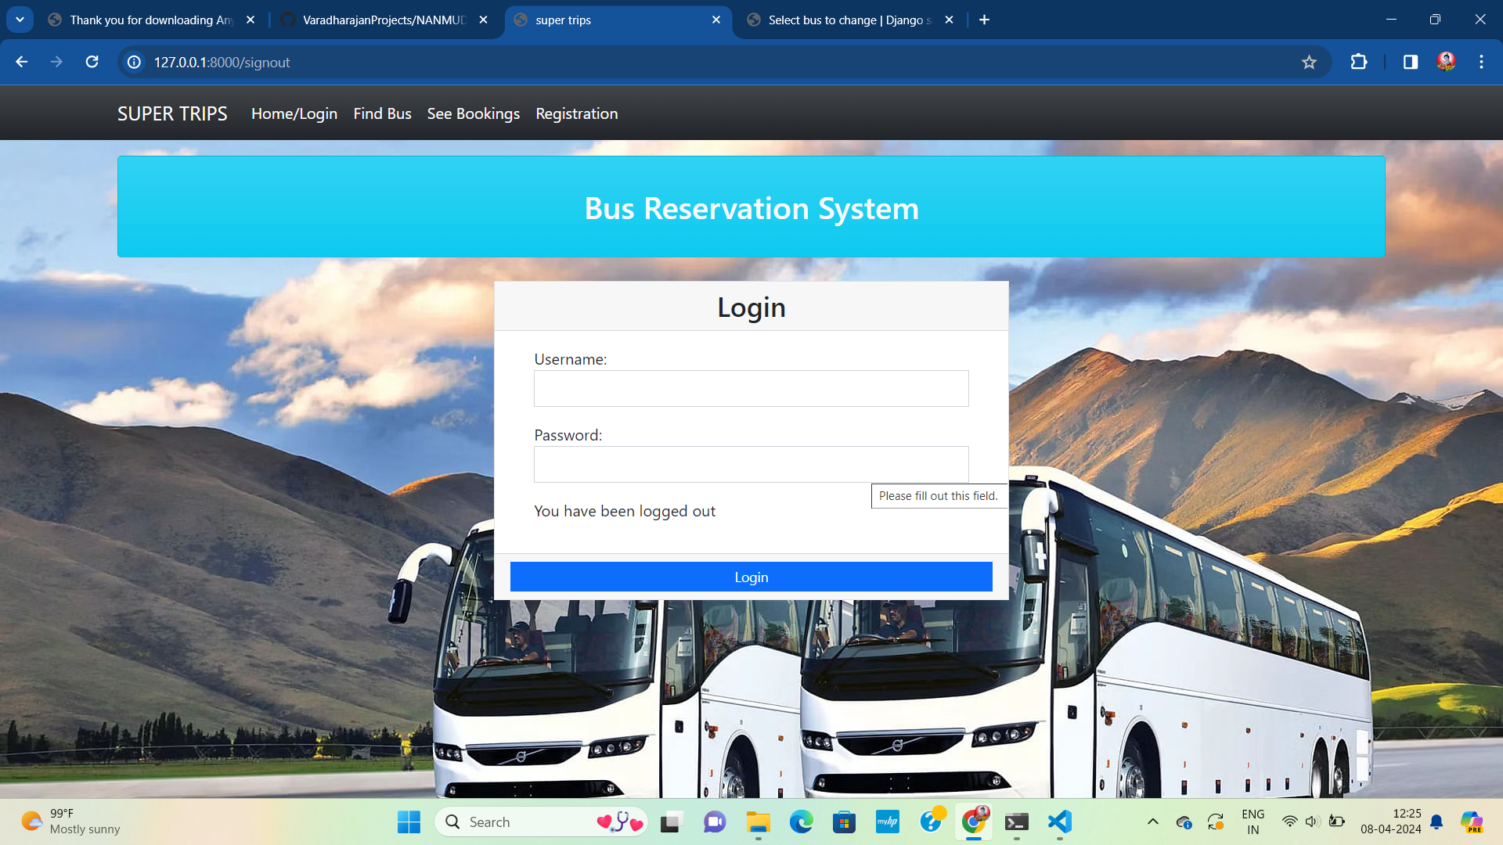
Blog-Page

Slide 16
Future Enhancements:
In future iterations, several enhancements can be integrated into the bus reservation system to amplify its functionality and user appeal. Firstly, the development of mobile applications for Android and iOS platforms would extend accessibility, allowing users to seamlessly book tickets and manage reservations from their smartphones. Dynamic pricing algorithms could be implemented to adjust ticket prices based on demand, optimizing revenue and encouraging early bookings. Integration with transit APIs would furnish real-time updates on bus locations and route changes, enhancing transparency and user experience. Introduction of promotional offers and loyalty programs could incentivize repeat bookings, fostering customer retention. Advanced analytics techniques and predictive modeling could further refine reporting capabilities, aiding in demand forecasting and route planning. Multi-language support would cater to a broader user base, promoting inclusivity. Moreover, exploring partnerships with ride-sharing services and integrating social media platforms would facilitate intermodal transportation options and community engagement respectively. Lastly, implementing accessibility features and exploring blockchain integration for ticket verification would ensure usability for all users and enhance security measures. These enhancements collectively aim to fortify the bus reservation system, enriching user experience, and positioning it at the forefront of industry innovation.

Slide 17
Conclusion
In conclusion, the development of a bus reservation system using Python and Django presents an innovative solution to streamline the booking process for passengers and enhance operational efficiency for administrators. Through the integration of user-friendly interfaces, robust backend functionalities, and advanced management tools, the system has the potential to revolutionize the transportation industry. The proposed enhancements, including mobile application development, dynamic pricing, real-time updates, and loyalty programs, offer avenues for further growth and optimization. By leveraging emerging technologies and industry best practices, the system can continue to evolve and adapt to meet the changing needs of users and stakeholders. Overall, the bus reservation system stands as a testament to the power of technology in improving accessibility, convenience, and reliability in public transportation services. Through ongoing innovation and collaboration, it has the potential to shape the future of travel and redefine the passenger experience.
Source :

Slide 18
Thank You!
Notes:
Thank You !!

